Slide 1
Basic Computer Organization
(Instruction Codes, Registers)

Slide 2
Instruction Codes
The organization of the computer is defined by its internal registers, the timing and control structure, and the set of instructions that it uses.
The Internal organization of a digital system is defined by the sequence of micro-operations it performs on data stored in its registers.
The user of a computer can control the process by means of a program.
A program is a set of instructions that specify the operations, operands, and the processing sequence.

Slide 3
Instruction Codes
A computer instruction is a binary code that specifies a sequence of micro-operations for the computer. Each computer has its unique instruction set.
Instruction codes and data are stored in memory.
The computer reads each instruction from memory and places it in a control register.
The control unit interprets the binary code of the instruction and proceeds to execute it by issuing a sequence of micro-operations.

Slide 4
Instruction Codes
An Instruction code is a group of bits that instructs the computer to perform a specific operation.
The most basic part of an instruction code is its operation code part.
The operation code of an instruction is a group of bits that defines certain operations such as add, subtract, shift, and complement.

Slide 5
Instruction Codes
The number of bits required for the operation code depends on the total number of operations available in the computer.
2^{n} (or little less) distinct operations
n bit operation code

Slide 6
Instruction Codes
An operation must be performed on some data stored in processor registers or in memory.
An instruction code must therefore specify not only the operation, but also the location of the operands (in registers or in the memory), and where the result will be stored (registers/memory)

Slide 7

Instruction Codes
An instruction code is usually divided into operation code, operand address and addressing mode.
The simplest way to organize a computer is to have one processor register (Accumulator AC) and an instruction code format with two parts (op code, address)

Slide 8
Stored Program Organization
0
Memory 4096x16
15
12
11
Opcode
Address
15
0
Instruction Format
Instructions (program)
15
0
Binary Operand
15
0
Operands (data)
Processor register (Accumulator AC)

Slide 9
Indirect Address
There are three Addressing Modes used for address portion of the instruction code:
  Immediate: the operand is given in the address portion.
  Direct: the address points to the operand stored in the memory.
  Indirect: the address points to the pointer (another address) stored in the memory that references the operand in memory.
One bit of the instruction code can be used to distinguish between direct & indirect addresses

Slide 10
Indirect Address
Instruction Format
15
14
12
11
0
I
Opcode
Address
Direct Address
Indirect address
22
0
ADD
457
35
1
ADD
300
300
1350
457
Operand
1350
Operand
+
+
AC
AC

Slide 11
Indirect Address
Effective address: the address of the operand in a computation-type instruction or the target address in a branch-type instruction
The pointer can be placed in a processor register instead of memory.

Slide 12
Computer Registers
Computer instructions are normally stored in consecutive memory locations and executed sequentially one at a time.
The control reads an instruction from a specific address in memory and executes it.
This type of sequencing needs a counter to calculate the address of the next instruction after execution of the current instruction is completed.
It is also necessary to provide a register in the control unit for storing the instruction code after it is read from memory.
The computer needs processor registers for manipulating data and a register for holding a memory address.

Slide 13
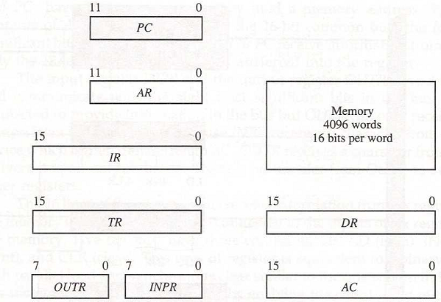
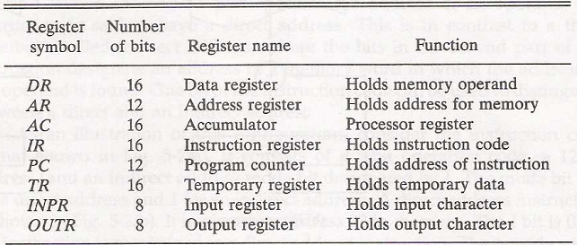
Registers for the Basic Computer
List of BC Registers

Slide 14
Common Bus System
Path must be provided to transfer information form one register to another register and between memory and registers.
The number of wires will be excessive if connections are made between the outputs of each register and the inputs of the other registers.
A more efficient scheme for transferring information in a system with many registers is to use a common bus system.

Slide 15
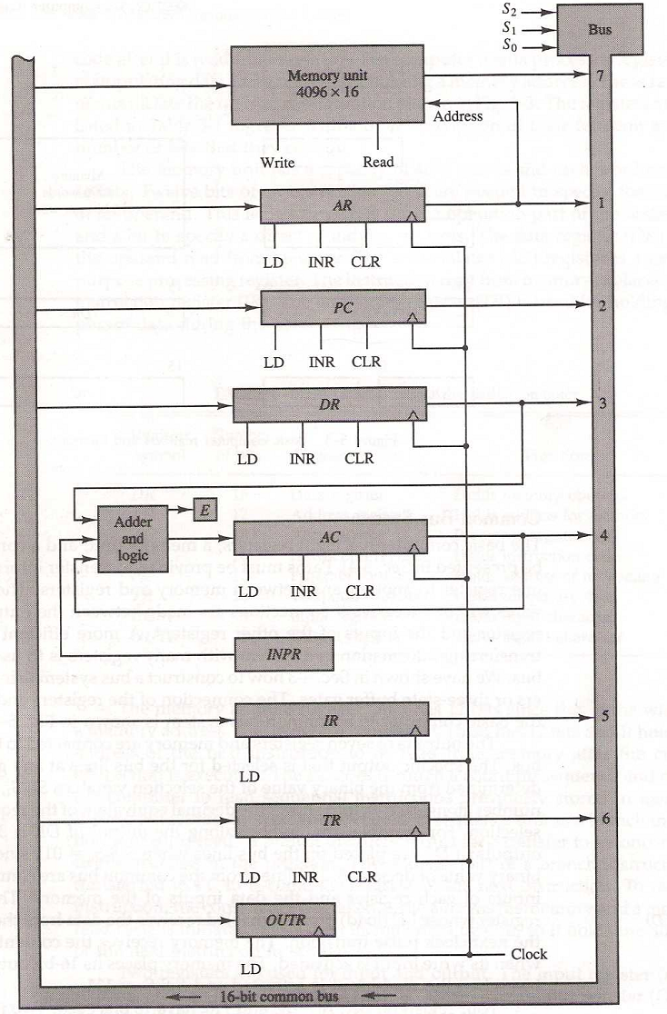
Basic computer registers connected to a common bus

